Slide 1
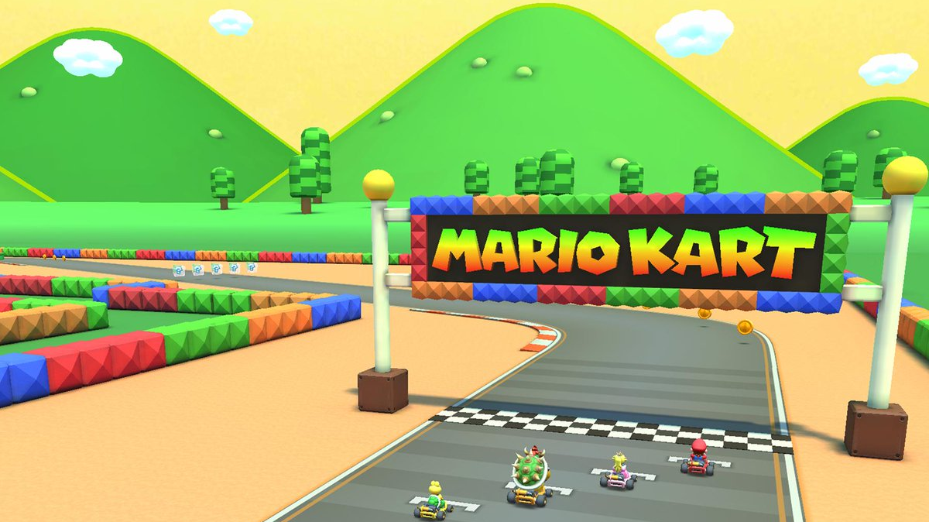
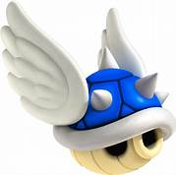
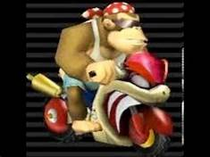
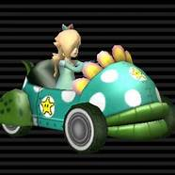
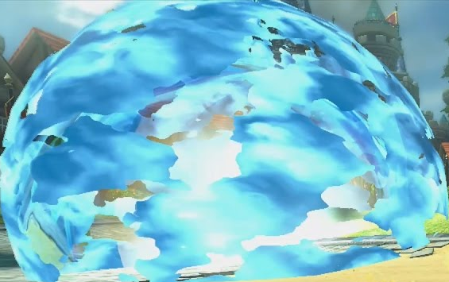
Ben Byrd
Caleb Eckerley

Slide 2

What are The Questions We are answering
Why do so many people speed run with the same Combinations?
What is truly the best combination?
Is there more factors than what the data?

Slide 3
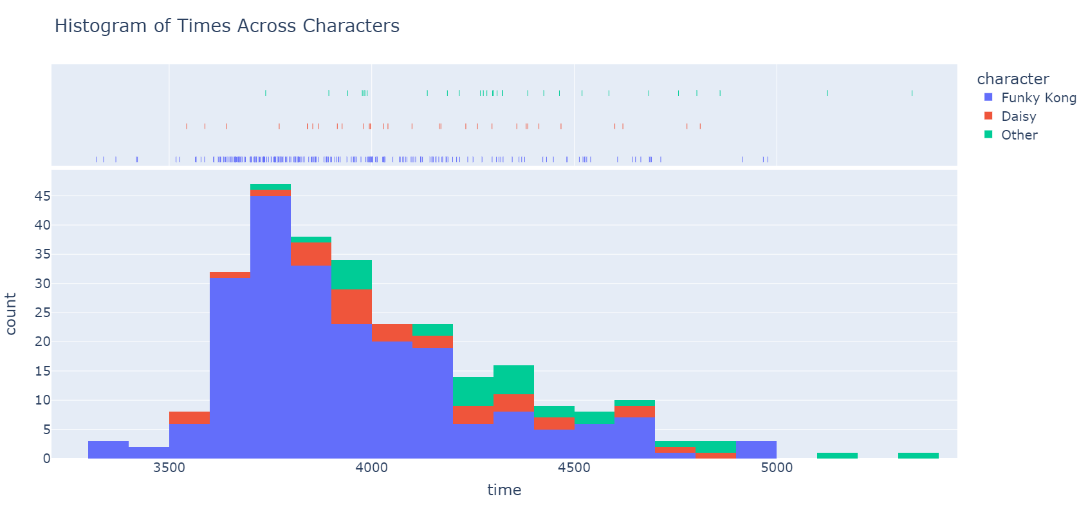
What is Commonly Used

Slide 4
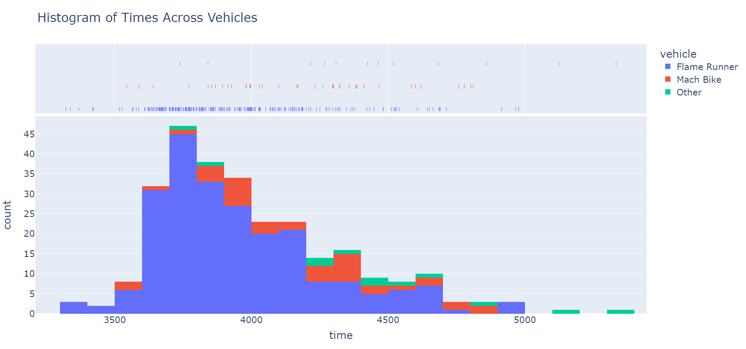
What is Commonly Used

Slide 5
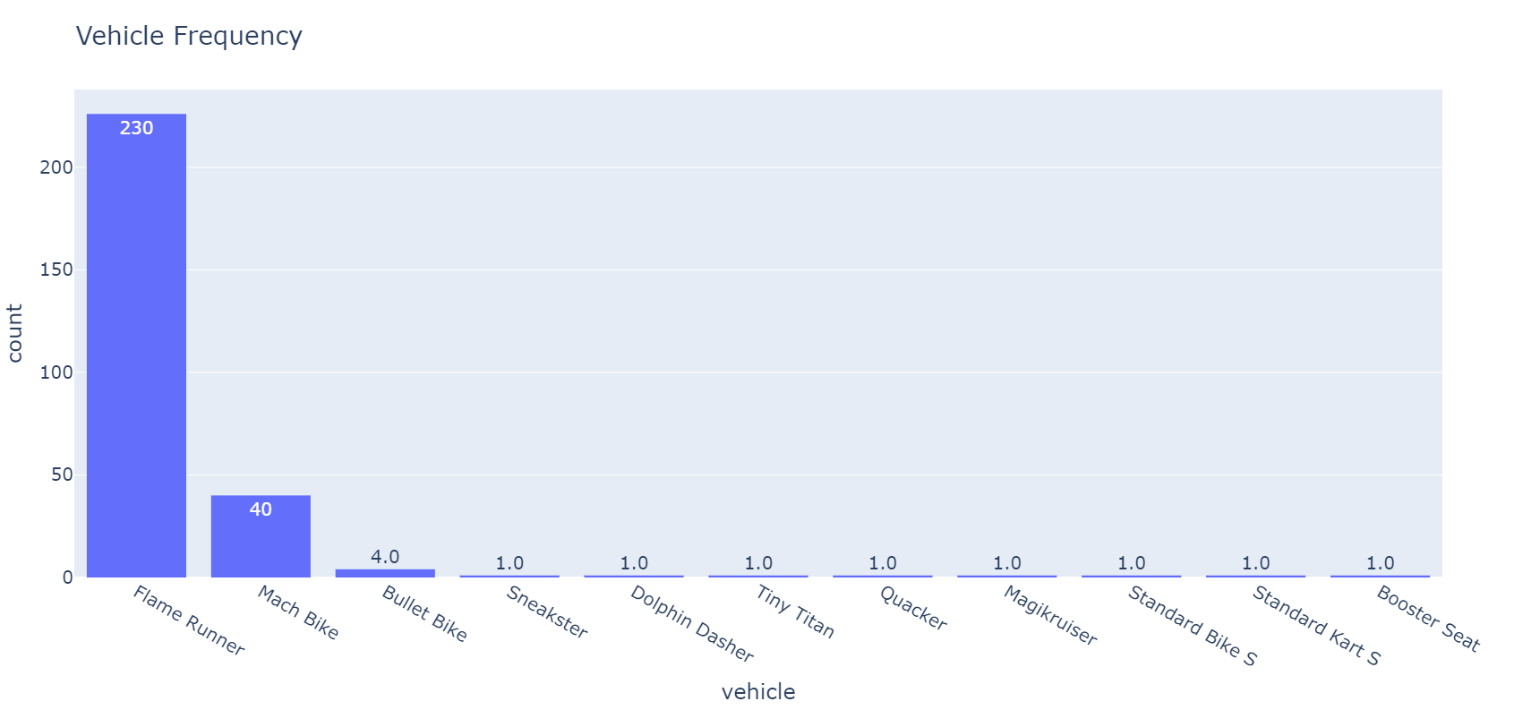

Slide 6
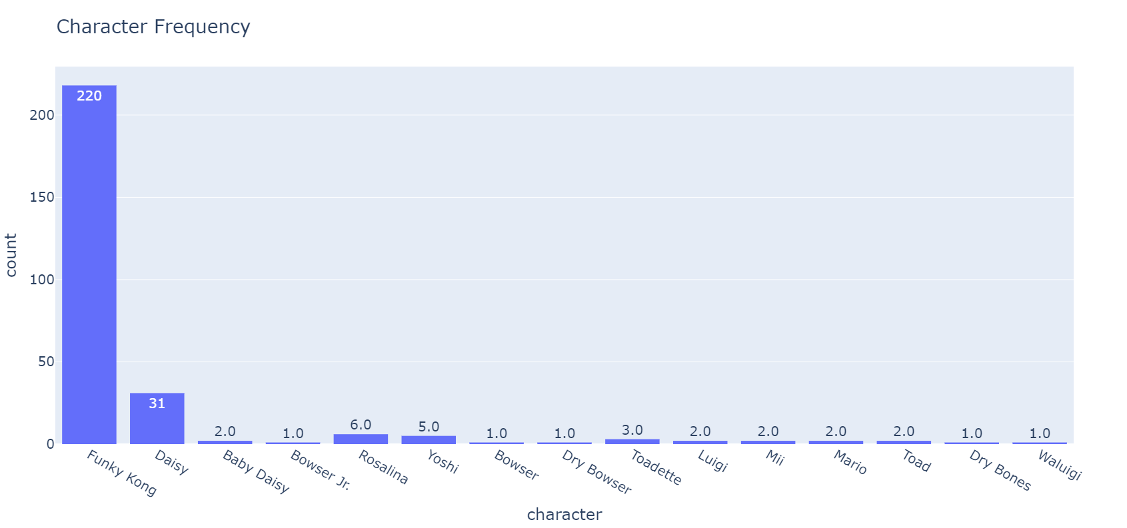

Slide 7
Traits of the Vehicles and Characters

Slide 8
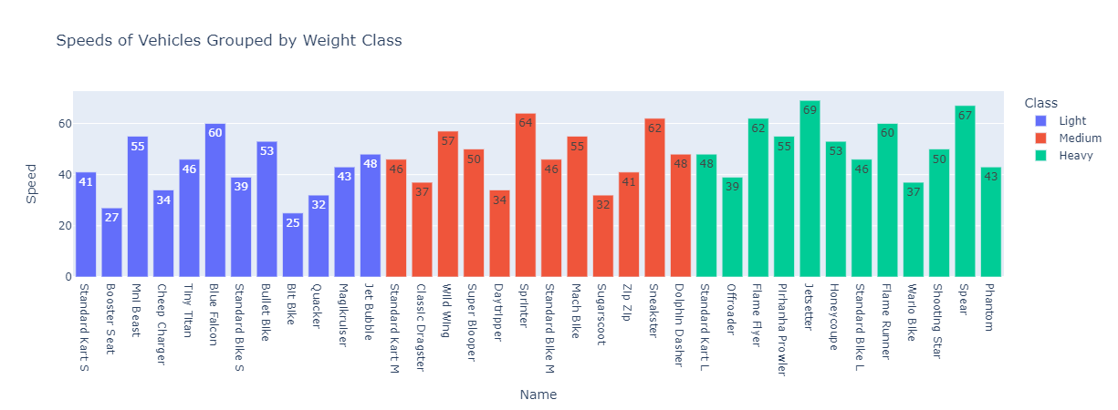
Speed Of Vehicles

Slide 9
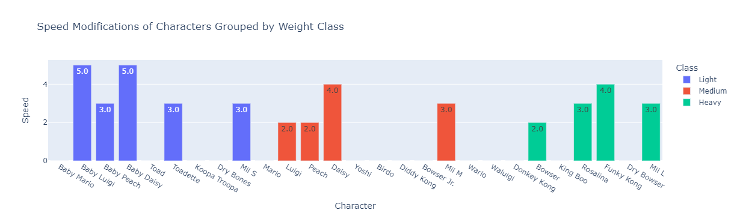
Speed Modifications of Characters

Slide 10
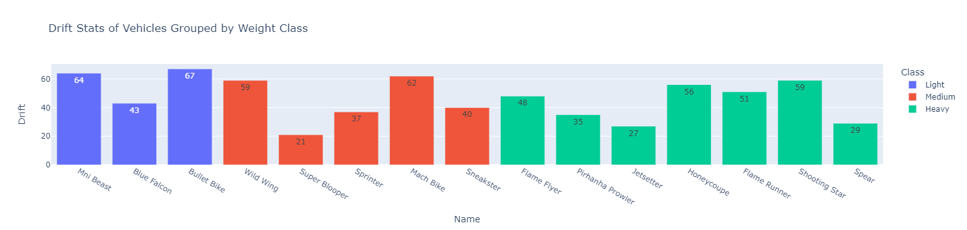
Drift Of Vehicles

Slide 11
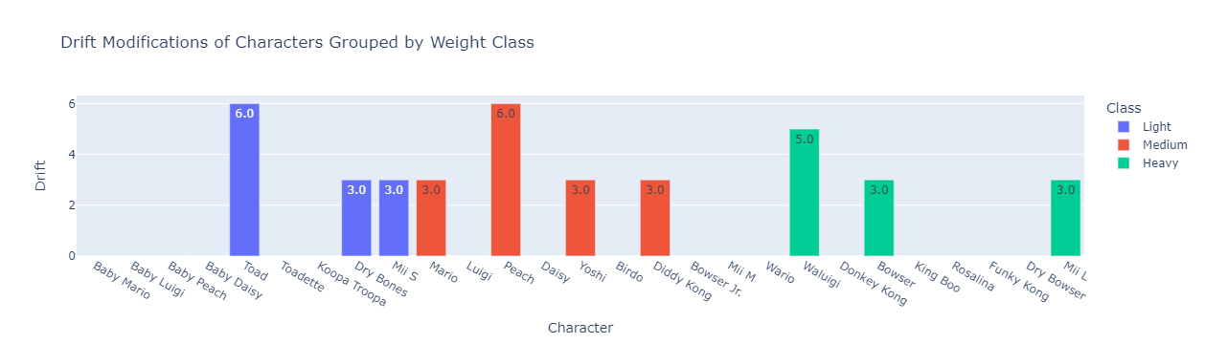
Drift Modifications of Characters

Slide 12
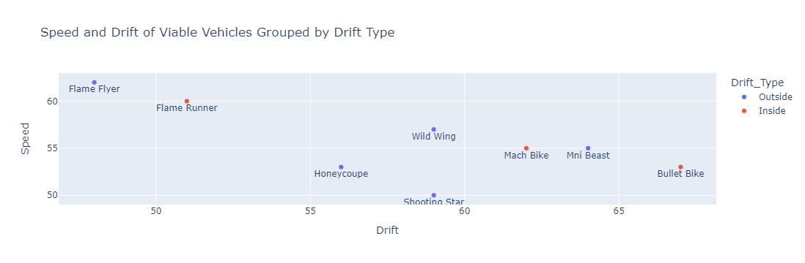

Slide 13
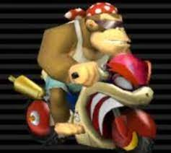
Final Verdict

